Slide 1
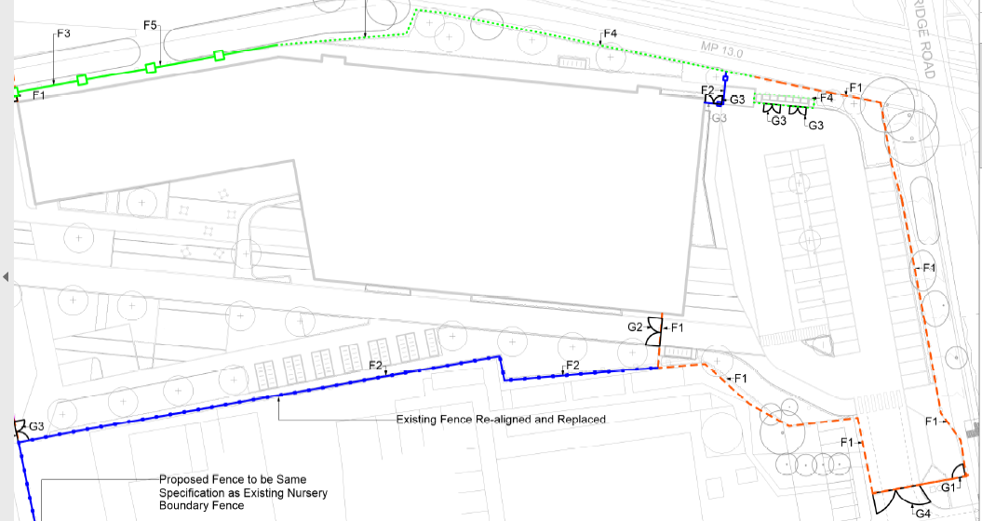
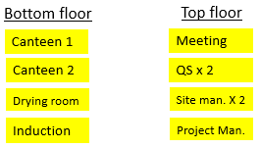
Site accommodation .
New building
Storage areas
14 car parking spaces – 35m
Barriers / fencng
4 on 4 double stacked
Vehicle Turning / Unloading Area
WC
Pedestrian walkway
Smoking area
Waste pipe may be able to be connected to Kingston FW drain
KLG Nursery
Turnstile

Slide 2
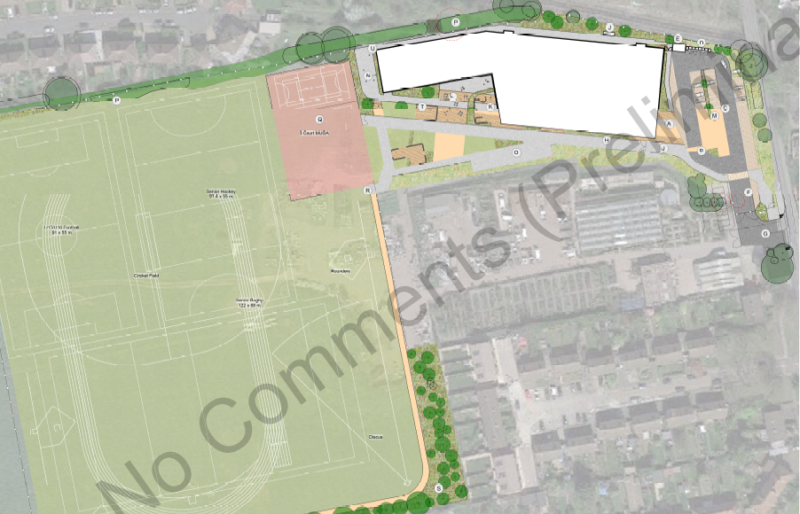
Overview of initial secure Site Boundary – Heras / Palisade fencing / hoarding .
Temp. contractors car park
Tree , Hedgerow protection
Site set up
Gateman / Security hut
KLG Nursery
Heras Fencing
Existing Palisade
Hoarding / Gates

Slide 3
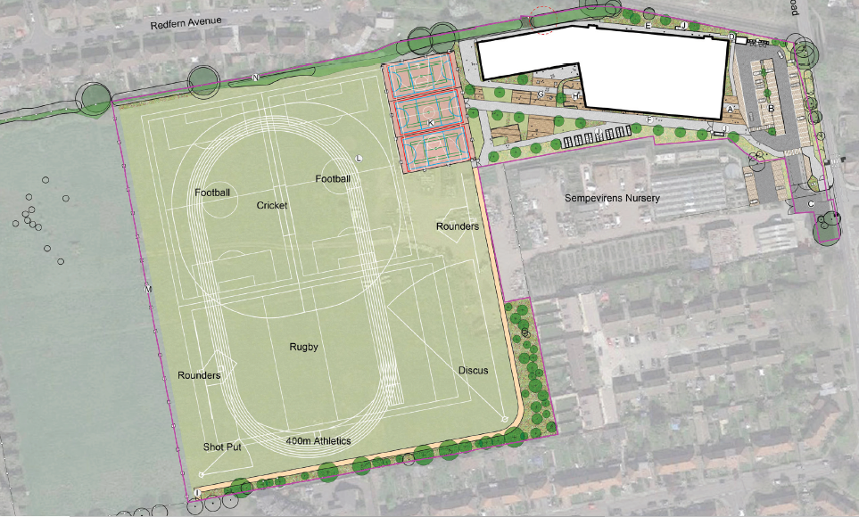
Overview of Eventual Boundary line
Habitat area

Slide 4
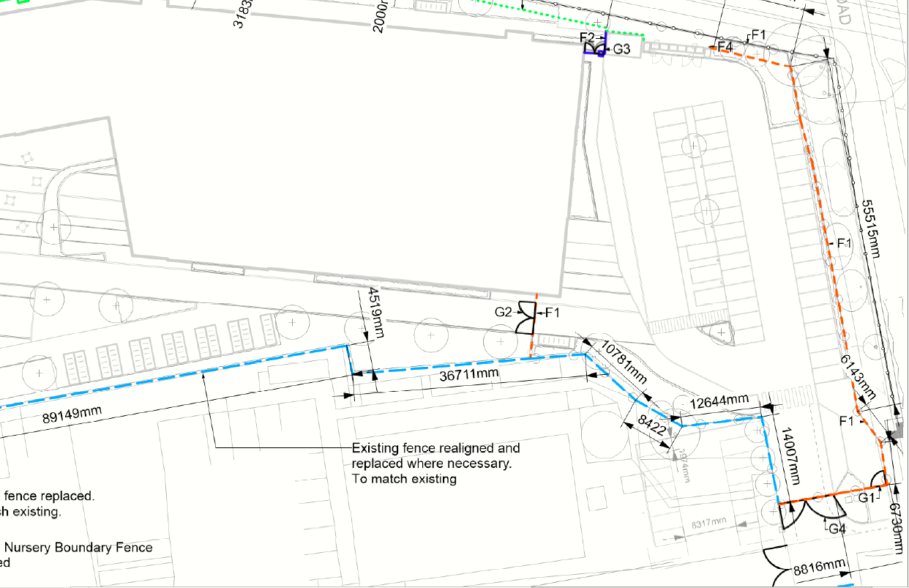
Site car parking
14 car parking spaces – 35m
Vehicle Turning / Unloading Area

